Slide 1
Crypto platform with MPC custodian technology
Front-end design and integration
July 2022

Slide 2
Integration of MPC-backend and the QAS crypto platform
Integration of Python and RUST
Declare and export our Rust functions in a Python module callable by the Python runtime.
Dependencies
PyO3 framework
Create bindings between RUST/Python functions and types.
Export RUST functions as a Python native module.
Maturin
Helper to build the RUST crate and export it in the Python project runtime.
Manage Python package metadata and distribution.
Notes:
exporting our rust functions in a Python module which can be imported in the python code.
PyO3 and Maturin are two frameworks that are usually used for speeding up python project with RUST, because as a low level language, RUST is much faster than Python.. So I think in our project, we can also leverage these two frameworks to call rust functions from Python.
Firstly, we are wrapping up the Rust code into a native python module with PyO3. It can map the RUST data type into Python data type.
Then, we use Maturin for the packaging, so that we can import the hybrid package in the same way as we import numpy or pandas in python.
To prove that the integration is done successfully. We can run the piece of python code that uses the secret sharing function, and to see if the result is right.

Slide 3
Front-end UI design: key distribution
Please provide the information of participants below
Private key distribution
Total number of participants: Least number of participants for key reconstruction:
Please provide the email addresses of participants:
Party 1
Email: test.test@ey.com
Party 2
Email: test.test@ey.com
Party 3
Email: test.test@ey.com
Party 4
Email: test.test@ey.com
Party 5
Email: test.test@ey.com
Party 6
Email: test.test@ey.com
Send Emails
Notes:
The next step is to implement the web page in the front end and the interactions between front end and backend.
The first web page is for the private key distribution. The administrator can set up the number of participants, the number of parties for key reconstruction, and also provide each parties’ email address.
Once it clicks this send emails button, the backend will do the computation and send shares to these email addresses.
The admin account has the entire private key and all the shares, it is still vulnerable to attackers. I think we can delete the private key from the admin account, once all shares are sent to the participants. So the transaction can only be approved by enough parties, and never ever any party has the entire private key.

Slide 4
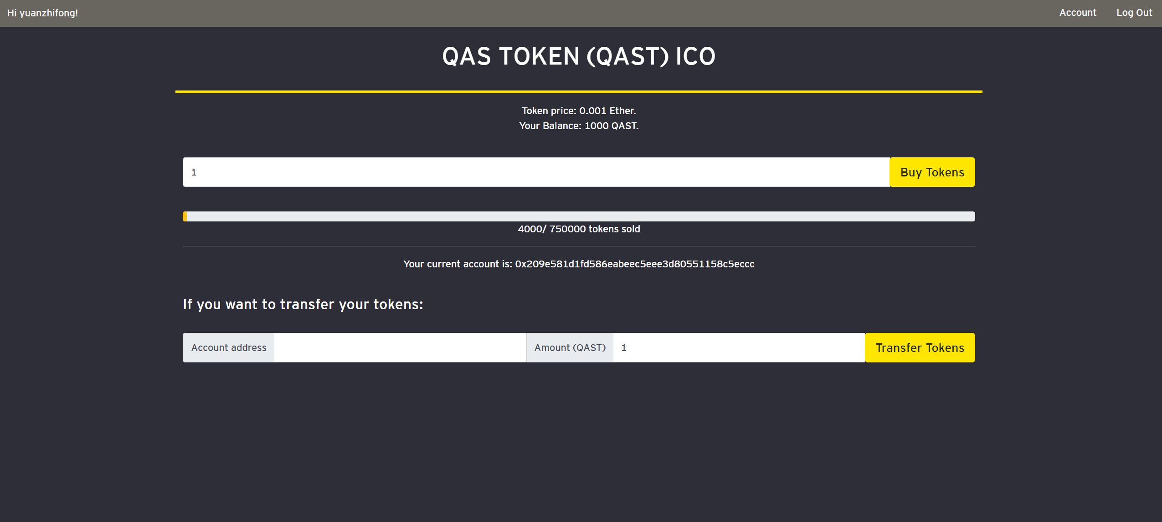
Front-end UI design: transaction
Notes:
The is the token transaction for users in the current platform, we can upgrade this webpage for transactions in the admin account.
Once the “Transfer Tokens” button is clicked, a new window should pop up for the key reconstruction.

Slide 5
Key reconstruction for transaction
Please provide the information of participants below
Please select a subset of parties to authorize this transaction:
Party 1
Email: test.test@ey.com
Party 2
Email: test.test@ey.com
Party 3
Email: test.test@ey.com
Party 4
Email: test.test@ey.com
Party 5
Email: test.test@ey.com
Party 6
Email: test.test@ey.com
Next

Slide 6
Key reconstruction for transaction
Please provide the information of participants below
When the admin account makes a transaction, it requires the shares a subset of participants..
The participant can either reject or authorize this transaction.
The partial key provided by the participant will be sent to the database in the backend of QAS crypto platform.
If enough shares are received, the backend will reconstruct the original private key and finish the transaction.
If the admin account have not received enough shares after 10 minute, the transaction will fail.
Hi, xxx,
The admin account of the QAS coin is making a transaction of xxx.
If you decide to authorize this transaction, please provide your partial private key:
Decline
Confirm

Slide 7
Interactions between the client and server
WebSockets
a persistent, open connection between the client and the server
Clients and the server can send messages to each other any time

